Slide 1
DATA ANALYTICS: DESCRIPTIVE vs PREDICTIVE vs PRESCRIPTIVE
Team 6
Nirupama Janapati
Pragati Sahu
Varsha Kollu
Vibhava Rayala (Lead)

Slide 2
PROJECT OBJECTIVE
To explore the multiple facets of data analytics.
To understand and distinguish the categories of data analytics currently used by organizations or enterprises in their business.
To know how influential and important data has become in today’s world.

Slide 3
DATA ANALYTICS
Data analytics examines raw data in order to draw conclusions about information.
This is a technique which enhances organizational productivity and enterprise gain.
This is mainly used by enterprises to make good decisions basing on their previous activities and thereby us the results to develop their enterprise.
The process to perform data analytics involves three simple steps:
Collect data
Categorize data
Identify data

Slide 4
FACTS
THE NEED FOR ANALYTICS
GARTNER ESTIMATES
9/10 people claim that decision would be better if relevant information was used.
15% of fortune 500 companies use data analytics today.
At end of 2016, 50% of global 1000 companies will use data analytics.
71% of the people struggle regularly with data inaccuracies.
WHEN DID IT START?
BUSINESS GROWTH
In the past 2years, 90% of the world’s data was created.
$10.2 billion $53.4 billion
http://www.ibmbigdatahub.com/gallery/quick-facts-and-stats-big-data
Notes:
The OpenStack project continues to grow with the number of companies and individuals involved growing at a rapid pace. As alluded to earlier, the number of code contributors outnumbering all but a small number of vendors.

Slide 5
TYPES OF DATA ANALYTICS
Descriptive analytics.
Ex: Walmart, Tableau
Predictive analytics.
Ex: Amazon, Netflix, Target
Prescriptive analytics.
Ex: Google self-driven Car

Slide 6

DESCRIPTIVE ANALYTICS
As the name implies they “Describe” or summarize raw data that can be interpretable by humans.
It allows us to learn from past behaviors and understand how it influences the future outcomes.
Business intelligence (BI) tools are used to perform descriptive analytics.
BI can handle enormous amounts of unstructured data to identify, aggregate and present data in formats such as dashboards and reports.

Slide 7

EXAMPLE: WALMART
Walmart captures transaction from all its stores and transmits the data to its data centers.
More than 3500 employees of Walmart are given access to the data related to their products which would help them to carry out data analytics.
We also came to know that Walmart uses “Tableau” BI tool for analyzing their data. This analyzed data represents the customer buying patterns which is used by the enterprise to manage their local store inventory.

Slide 8
BI TOOLS FUNCTIONALITIES
These tools help us by giving the following outputs:
Get fast answers to critical business questions.
Reduce time spent on data entry and manipulation.
Boost productivity
Identify areas for cost cutting

Slide 9

BI TOOL THAT WE USED- TABLEAU
Tableau makes it easy for users to connect with data and create visual reports irrespective of technological knowledge by providing flexible features. The platform is as simple to use as Excel. It provides very rich features like sharable dashboards, interactive reporting and scalability make for one-click access to any data the user needs to analyze.
Features:
Tableau allows us to choose between the cloud-based Tableau Online and premise Tableau Server.
One-click gives us answers in fraction of seconds.
It shares the dashboards and enables the users to explore further.

Slide 10
REQUIREMENTS FOR DEMO
Hardware Requirements:
Tableau Server authenticated via Active Directory
Tableau Desktop
8GB of RAM, 64 Bit OS.
Windows 10 Operating System

Slide 11
DEMO

Slide 12

LEARNING ANALYSIS IN CANVAS
Instructure is a SAAS (Software as a Service) who created canvas .Its delivered through redshift on Amazon.
Canvas is a Learning Management System (LMS)
Founded by Brian Whitmer and Devlin Daley, with funding from Josh Coates ( Currently the CEO )
Canvas Data is supported by key partnerships with Civitas Learning (Predictive Analytics) and Intellify (Learning Intelligence) to provide clients with the most comprehensive access to new information.
Learning analytics (LA) in Canvas collect and analyse student usage patterns. These data can allow instructors to examine relationships between student engagement and learning outcomes.

Slide 13
USES OF LEARNING ANALYTICS
The most common use of learning analytics is to identify students who are not succeeding academically and to inform targeted interventions.
It helps to identify the assignments that cause difficulty to the students. Instructors can use these data to adapt and modify curriculum or assignments.
The significant feature of LA is that it tracks more data than an instructor can collect on his own, especially in large courses.
LA provides a better understanding to the student and instructor about the learning process and takes an action to improve the learning outcomes.
More specifically, analytics collects log-in information, rates of participation in specific activities, amount of time spent interacting with online resources or with other students and sometimes student grades.
The software can then compare student’s activity with other students who are currently enrolled in the course or those who already took the course and against rubrics to create a model for student performance.

Slide 14
LA collects and analyses the “digital breadcrumbs” – Meaning a trail that a student leaves when he is interacting on the internet.
LA applications can identify factors that are unexpectedly associated with student learning and course completion.
The Above Document from:
The SJSU IT Department managing canvas.
Other References on canvas:
net.educause.edu
www.docurated.com
https://bostoncollege.instructure.com/courses/1292000/pages/analytics-in-canvas
https://www.canvaslms.com/news/press-releases/instructure-launches-canvas-data

Slide 15
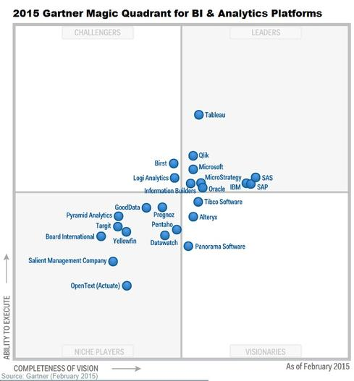

Slide 16
TABLEAU vs YELLOW FIN
 | TABLEAU | YELLOW FIN
Usage | Easy to use | Difficult to use
Deployment issue | No | Yes
Scalability | Good | Excellent
Location intelligence | No | Yes
API | Yes | No
Customer | Medium, large business | Startup, small, medium and large business.
Multiple Language | Yes | No
Dashboard | User friendly | Not so user friendly
Price | $500/yr | $600/yr

Slide 17
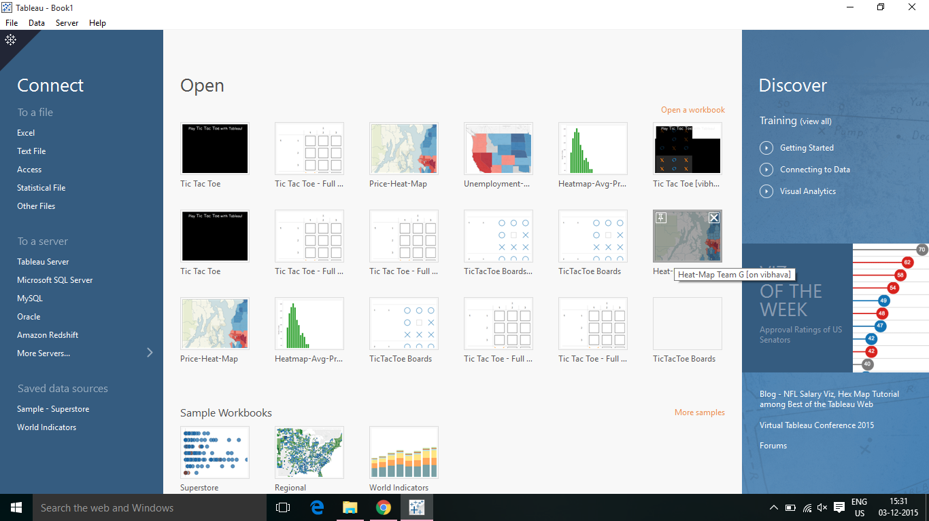
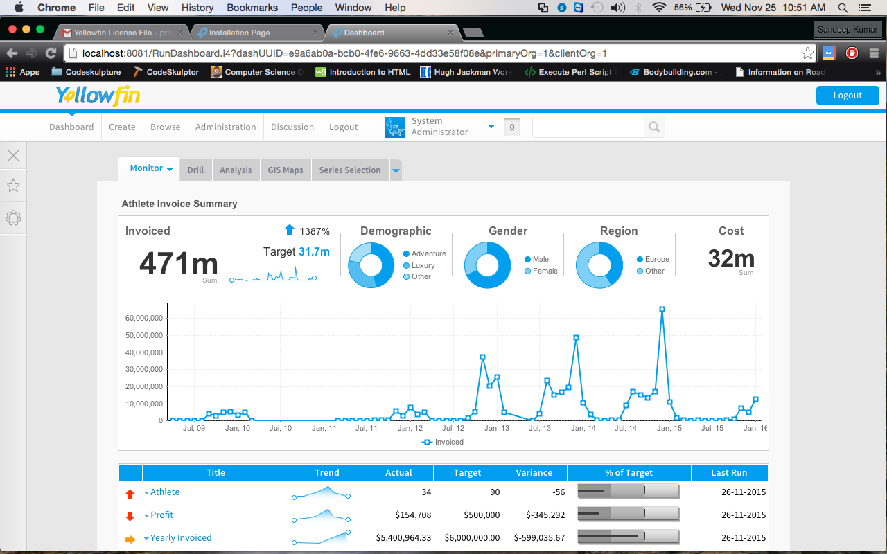

Slide 18
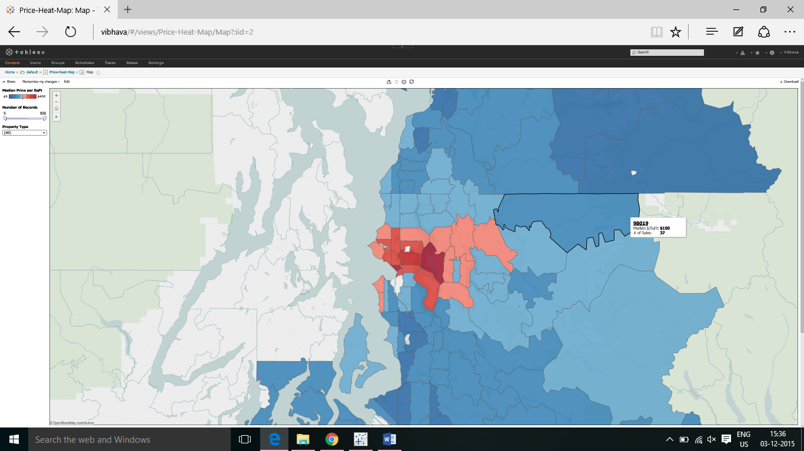
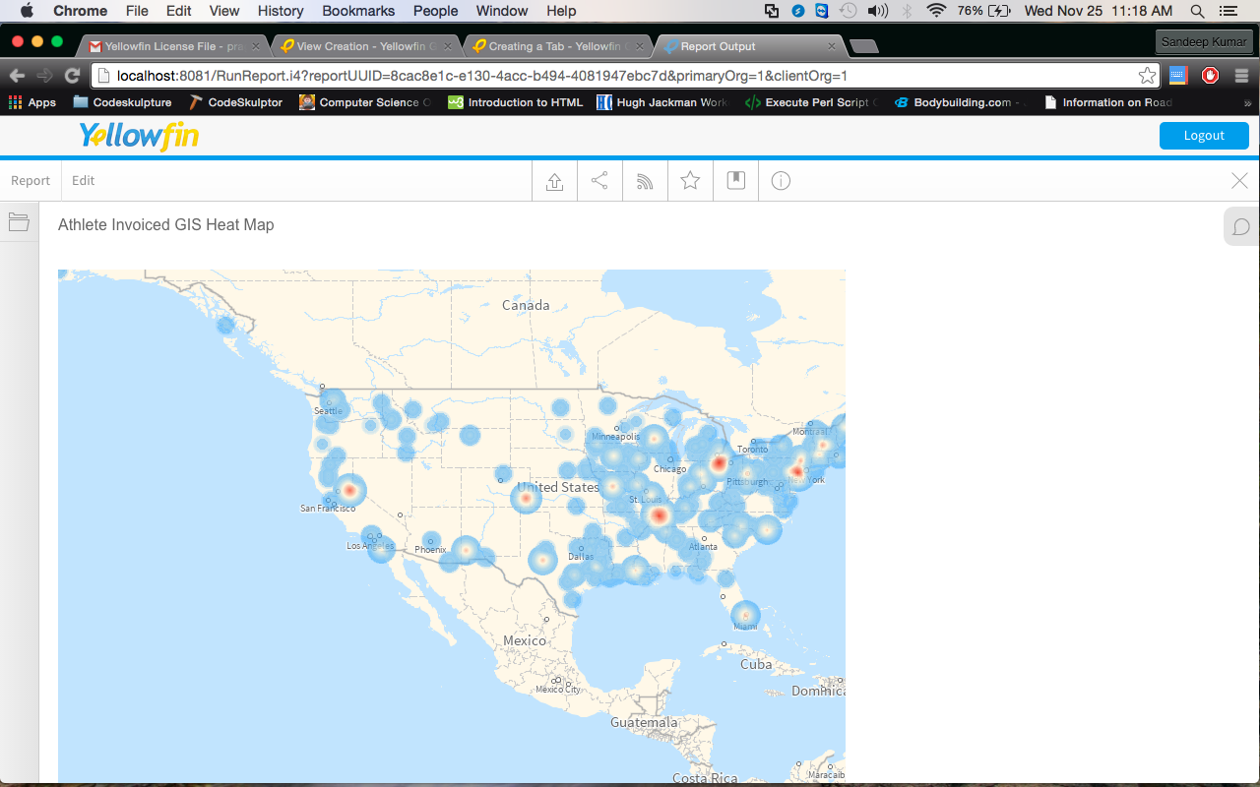

Slide 19
PREDICTIVE ANALYTICS

Slide 20
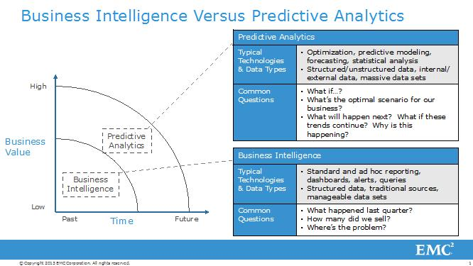

Slide 21
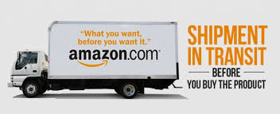
DID YOU KNOW?
Amazon.com, the Seattle-based ecommerce giant, ships us products even before we make a decision to buy.
Amazon Anticipatory Shipping!!!!

Slide 22
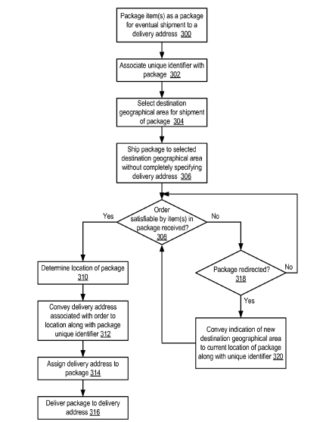
SHIPPING PROCESS
Amazon packs one or more items for eventual shipment to a delivery address.
It selects a destination area which determines where the package has to be shipped.
It then ships the package without completely specifying the delivery address at time of shipment to that destination area.
In the mean time while the package is in transit, if an order is received which satisfies the items in that respective package then it specifies the exact delivery address for that package.

Slide 23
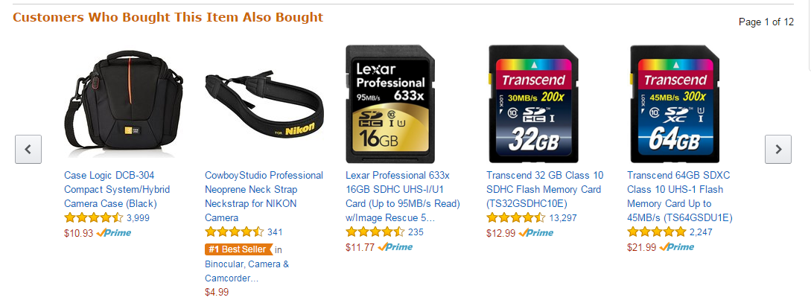
AMAZON RECOMMENDATIONS
“Customers who bought this item, also bought this one…”

Slide 24
HOW AMAZON DOES THESE?
Amazon analyses data by using item-to-item collaborative filtering on many data points like:
What users have bought before?
What users have in their virtual shopping card or wish list?
Items they have rated and reviewed
What other similar users have bought?
Customizes the customer browsing experience.
PREDICTIVE ANALYTICS

Slide 25
GOOD & BAD ABOUT AMAZON’S PREDCTIVE SHIPPING
Good:
Reduces time between ordering and receiving purchases.
Tailoring customer’s needs.
Improved Customer Satisfaction and Business.
Expanding its warehouse network to ensure overnight deliveries.
Bad:
Their algorithm might err sometimes, prompting costly returns.
Analyzing personal behavior in shopping patterns might lead to wrong suggestions.
Logistics costs for shipping the product out and then returning incurs waste of money.
What might actually work for Amazon:
For items that customers want on the day they are released.
When suggested items are already in transit, it ensures they are delivered.

Slide 26
WHAT IS PREDICTIVE ANALYTICS?
It predicts future outcomes by finding and quantifying the hidden patterns in the data using complex mathematical models.
Forecasts behavior, results in order to guide specific decisions.
Identifies risks or opportunities in the future.
Techniques used are:
Machine learning
Data Mining
Modeling
The keystones of predictive analytics are:
Decision analysis
Decision optimization
Transactional profiling
Predictive modeling
Predictive search
“You basically take data that you have, to predict data which you don’t have.”

Slide 27
RISKS OF PREDICTIVE ANALYTICS
Over-reliance on the predictive tools causes the following risks:
Predictive analytics is not absolute.
Bad Data
Data can be bad because it includes self-reporting errors, poorly phrased questions, corrupted files, poor standardization methods and incomplete data aggregation.
Privacy and security
Complexity and unpredictability
Predictive analytics is a set of statistical techniques which requires all data to be standardized and quantified. Quantifying non-numeric data has its own risks and creates uncertainty.

Slide 28
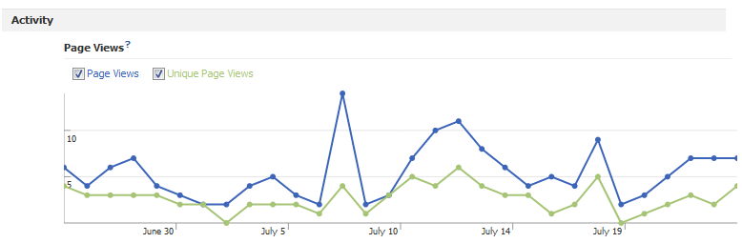
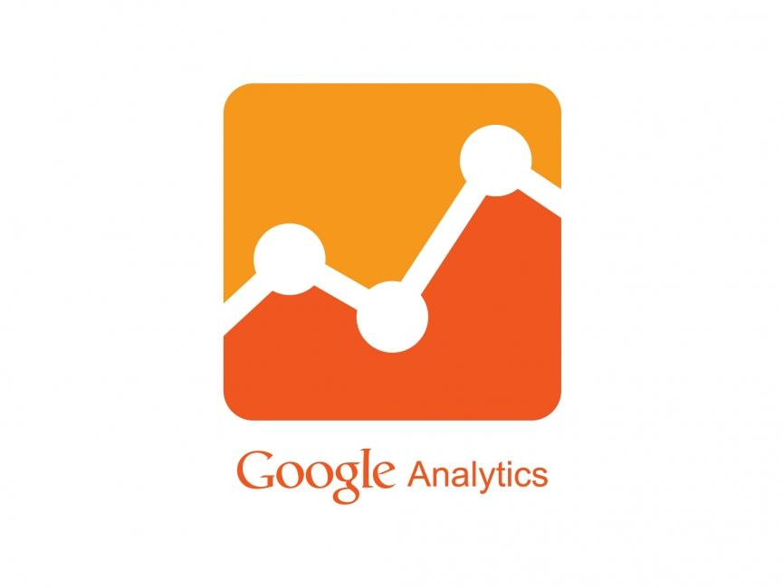

GOOGLE ANALYTICS vs FACEBOOK INSIGHTS
Google Analytics
Most widely used web analytics service on the Internet which tracks and reports website traffic.
Can be used with Facebook to get the users demographics
Facebook Insights
Captures information
about the visitors and their demographics
specifically their gender/age group
No of likes, clicks etc.,
Google Analytics | Facebook Insights
Cannot access most Facebook-related implementations. | Can give very detailed information of the users, their actions.
Provides more varied and interactive reports | Reports generated are really limited.
Better segmentation capabilities | Less Segmentation capabilities

Slide 29
MACHINE LEARNING
Machine learning explores the construction of algorithms which learns from and make predictions on data.
It focuses a lot on building algorithms.
Example: Netflix or Amazon recommends products to users using machine learning which predicts what would be interesting.

Slide 30
DEMO

Slide 31
PRESCRIPTIVE ANALYTICS
Prescriptive analytics provides information to maximize the chances of a future event occurring, based on comparing the predictive analyses of multiple options.
Examples:
Google self driven car.
Health care (Future implementation)

Slide 32
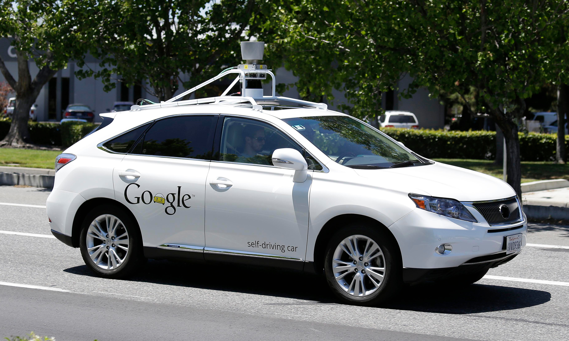
GOOGLE SELF-DRIVING CAR
Google self driving car makes decisions based on predictions and future outcomes. They anticipate on what’s coming and what would be the effect of a possible decision in order to prevent an accident.
FACT: 3% OF COMPANIES USE THIS TECHNIQUE BUT WITH LOT OF ERRORS.

Slide 33
HEALTH CARE(FUTURE IMPLEMENTATION)
Prescriptive analytics benefits healthcare strategic planning by combining operational and usage data with data of external factors to accurately plan for future capital investments such as new facilities and equipment utilization and also to understand the trade-offs between adding additional beds and expanding an existing facility versus building a new one.

Slide 34
DESCRIPTIVE vs PREDICTIVE vs PRESCRIPTIVE
 | DESCRIPTIVE | PREDICTIVE | PRESCRIPTIVE
What questions to ask? | What HAS happened? | What COULD Happen? | What SHOULD happen?
Function | Easiest to derive 'hard facts' from the given data sets. | Uses descriptive analysis's 'hard facts' to extrapolate (make inferences) about where unknown data may lie | Compiles predictive hypotheses and recommends a plan of action to maximize the likelihood of something happening.
Tools used | BI tools like Tableau, Qlik, Excel sheet etc | Google analytics, IBM analytics, weka, MATLAB etc | No successful tool till now.
Usage | Excessively used | Decently used | Not much used
Analytics answers | Dashboards, Reports, OLAP drill down | Report, Forecast, Simulation. | Optimization, Random variable optimization
Real time example | Walmart | Target, Amazon, Netflix, Bank of America | Google self-driven car

Slide 35
What Martin Fowler has to say about Big Data analytics?
Extraction of data from a wider range of sources.
Changes to the logistics of data management with new database and integration approaches.
The use of agile principles in running analytics projects.
An emphasis on techniques for data interpretation to separate signal from noise.
The importance of well-designed visualization to make that signal more comprehensible.
https://www.thoughtworks.com/insights/blog/thinking-about-big-data

Slide 36
REFERENCES
http://practicalanalytics.co/predictive-analytics-101/
https://infocus.emc.com/william_schmarzo/business-analytics-moving-from-descriptive-to-predictive-analytics/#prclt-tScy18Ip
https://halobi.com/2014/10/descriptive-predictive-and-prescriptive-analytics-explained/
http://www.informationweek.com/big-data/big-data-analytics/big-data-analytics-descriptive-vs-predictive-vs-prescriptive/d/d-id/1113279
https://canvas.instructure.com/courses/884561/pages/three-uses-of-statistical-analytis
http://www.theguardian.com/technology/2012/apr/23/google-tracking-trackers-cookies-web-monitoring
http://blog.bigml.com/2013/02/15/everything-you-wanted-to-know-about-machine-learning-but-were-too-afraid-to-ask-part-one/
http://www.rosebt.com/blog/predictive-descriptive-prescriptive-analytics

Slide 37
THANK YOU!

